Slide 1
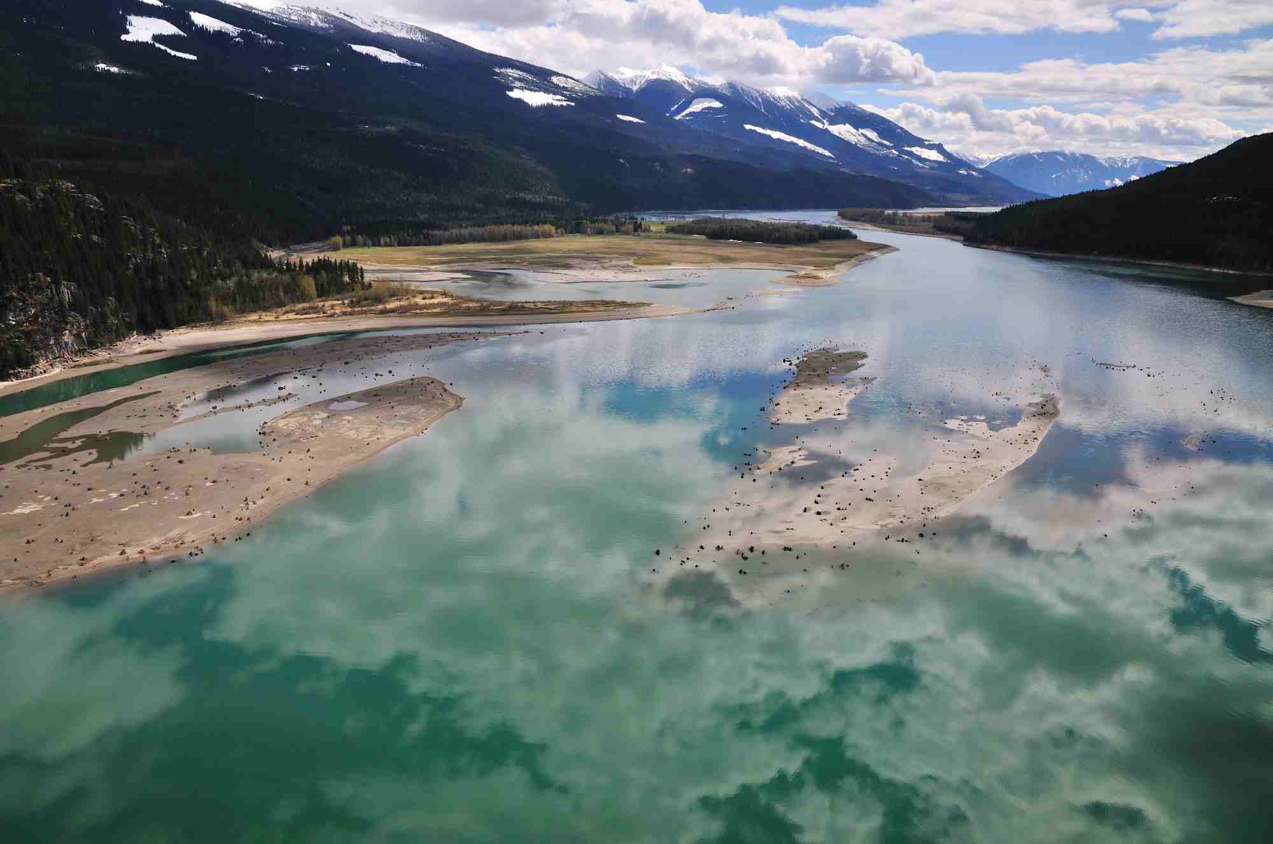
50 Years of Habitat Change in the Revelstoke Reach
Notes:
Synthesis of several projects – wlr and museum
Not a sciency talk, more just looking at changes over time

Slide 2
Created with the Construction of the Hugh Keenleyside dam in Castlegar, in 1969.
Impounded ~200km of the Columbia river, and Upper and Lower Arrow lakes.
Losses as reported by Utzig and Schmidt (2011):
Wet forests 19%
Wetlands 26%
Gravel bars 53%
Cottonwoods 21%
Shallow water/ponds 31%

Slide 3
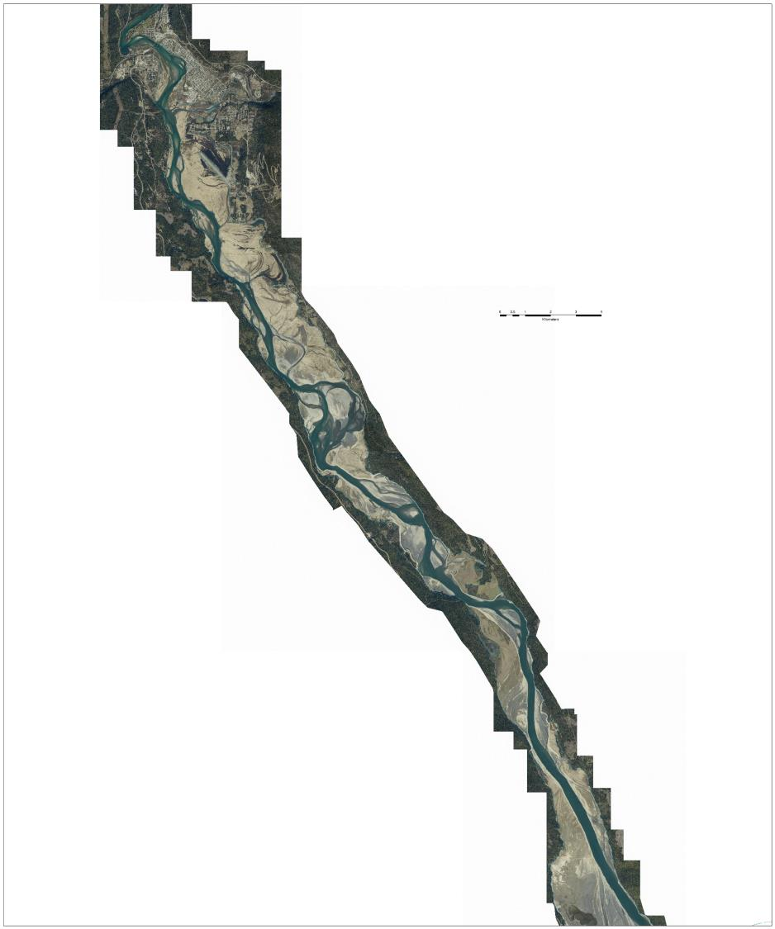
Notes:
The reach as it exists today

Slide 4
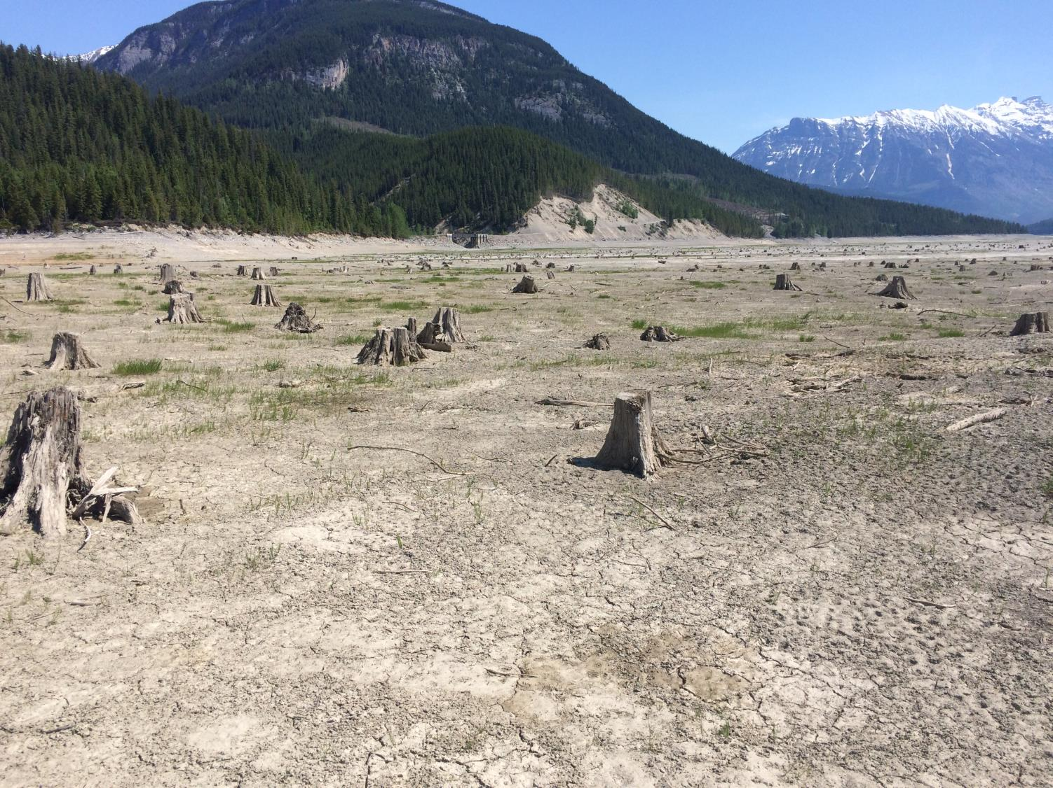
Notes:
Most reservoirs are mostly unvegetated rocky an silty moonscapes. Sometimes with flood tolerant vegetation, but more commonly not as vegetated as the revelstoke reach.

Slide 5
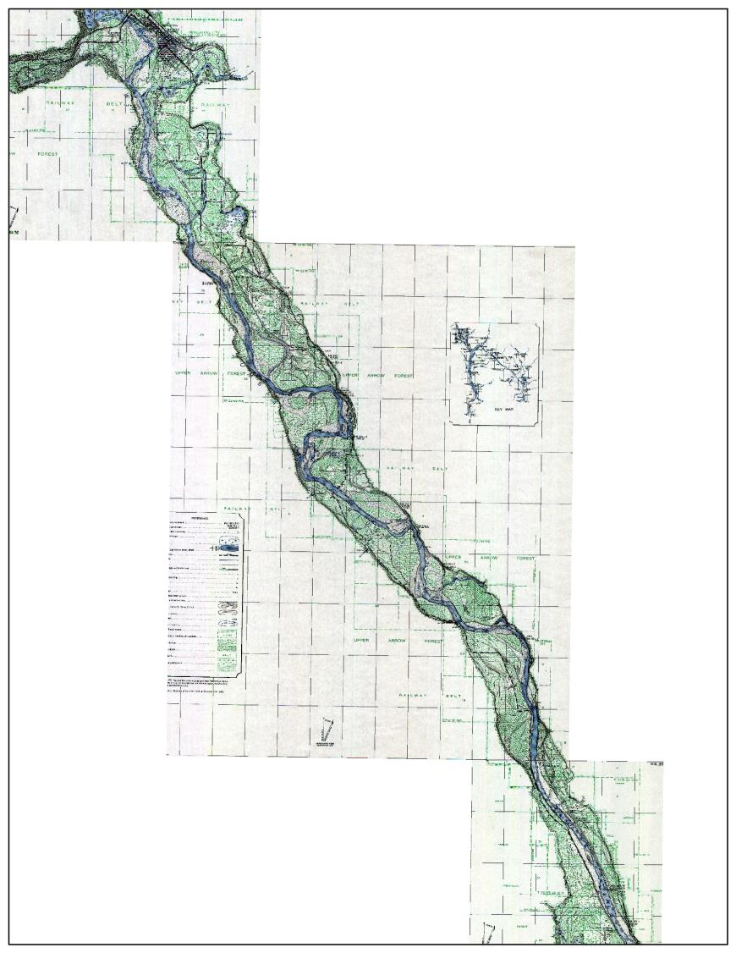
Notes:
Historic mapping shows mostly forested cover and agricultural use, post European settlement.

Slide 6
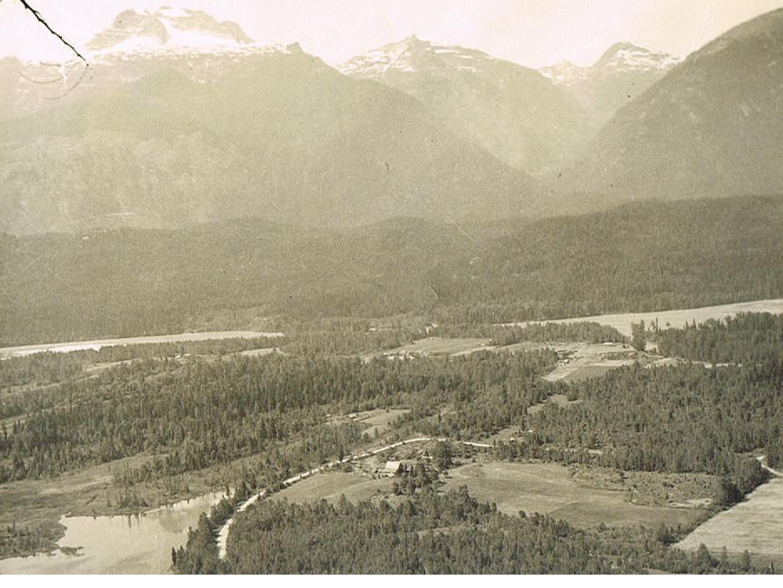

Slide 7
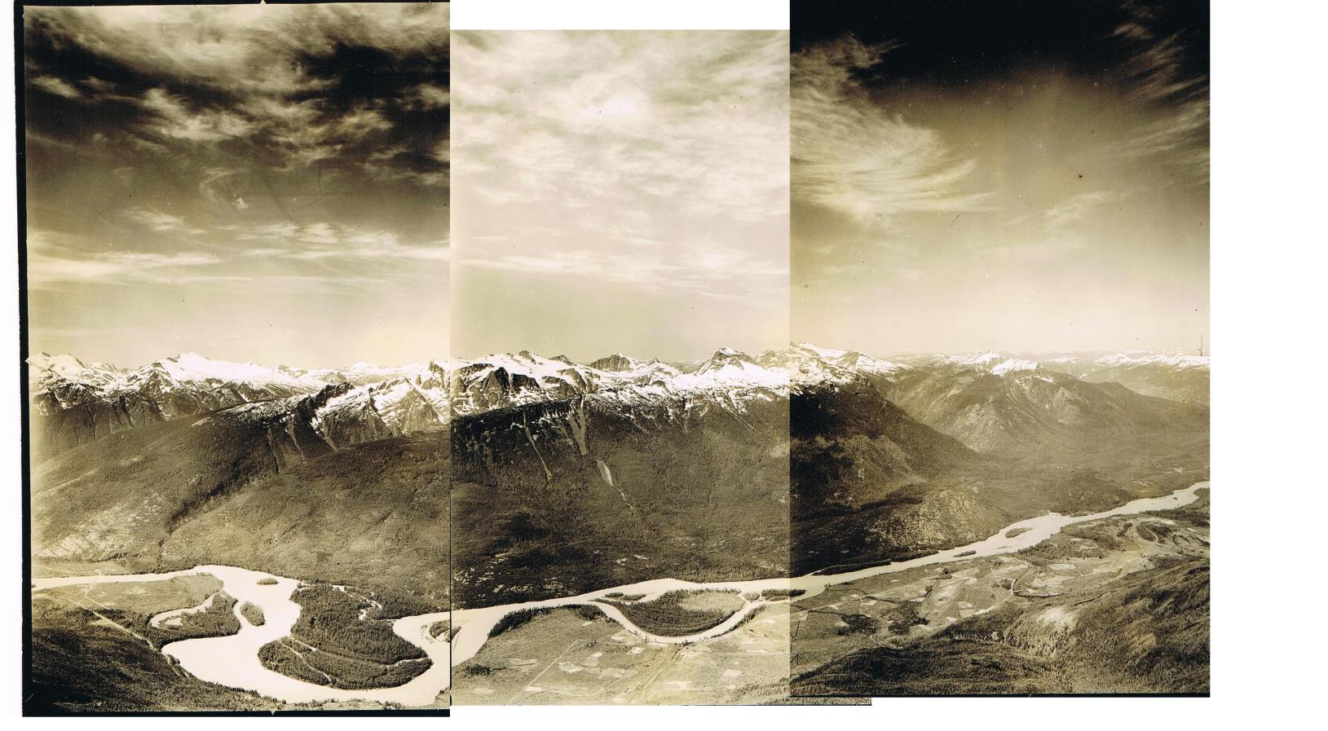

Slide 8
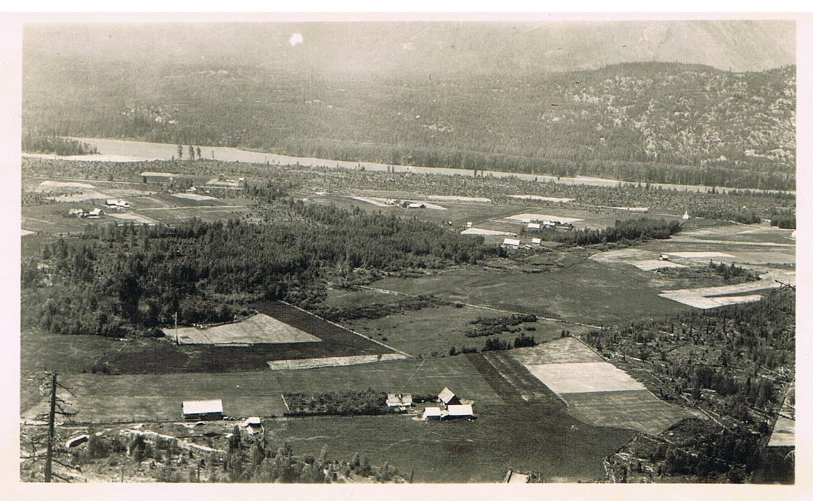

Slide 9
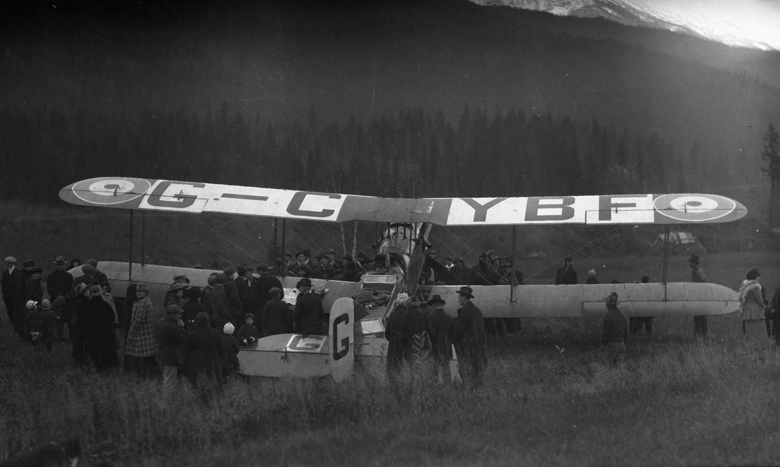

Slide 10
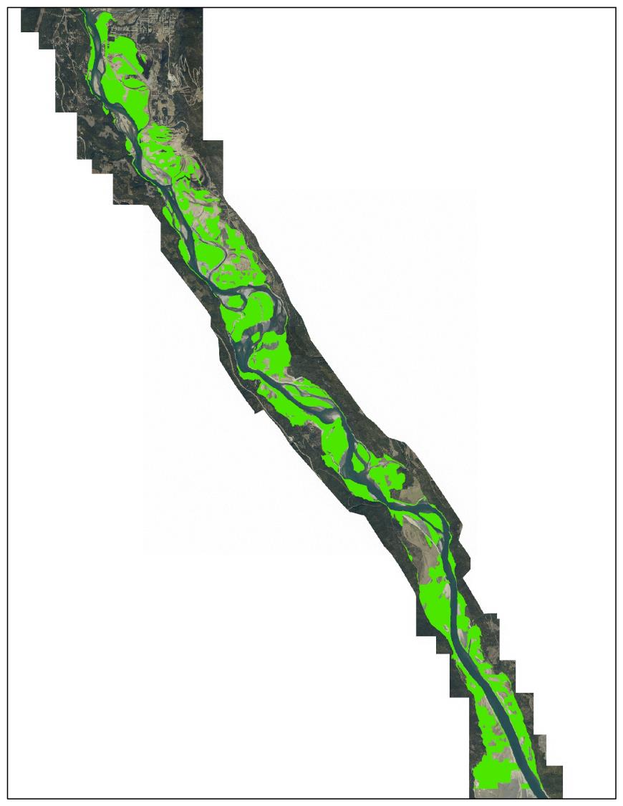
Forested land
Historic cover:
3118 ha

Slide 11
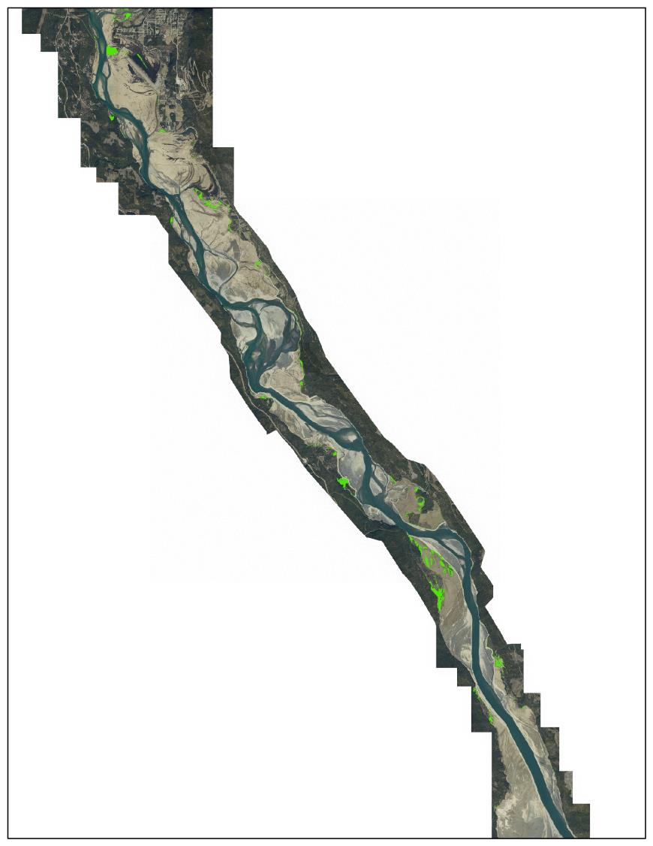
Forested land
Current cover:
338 ha

Slide 12
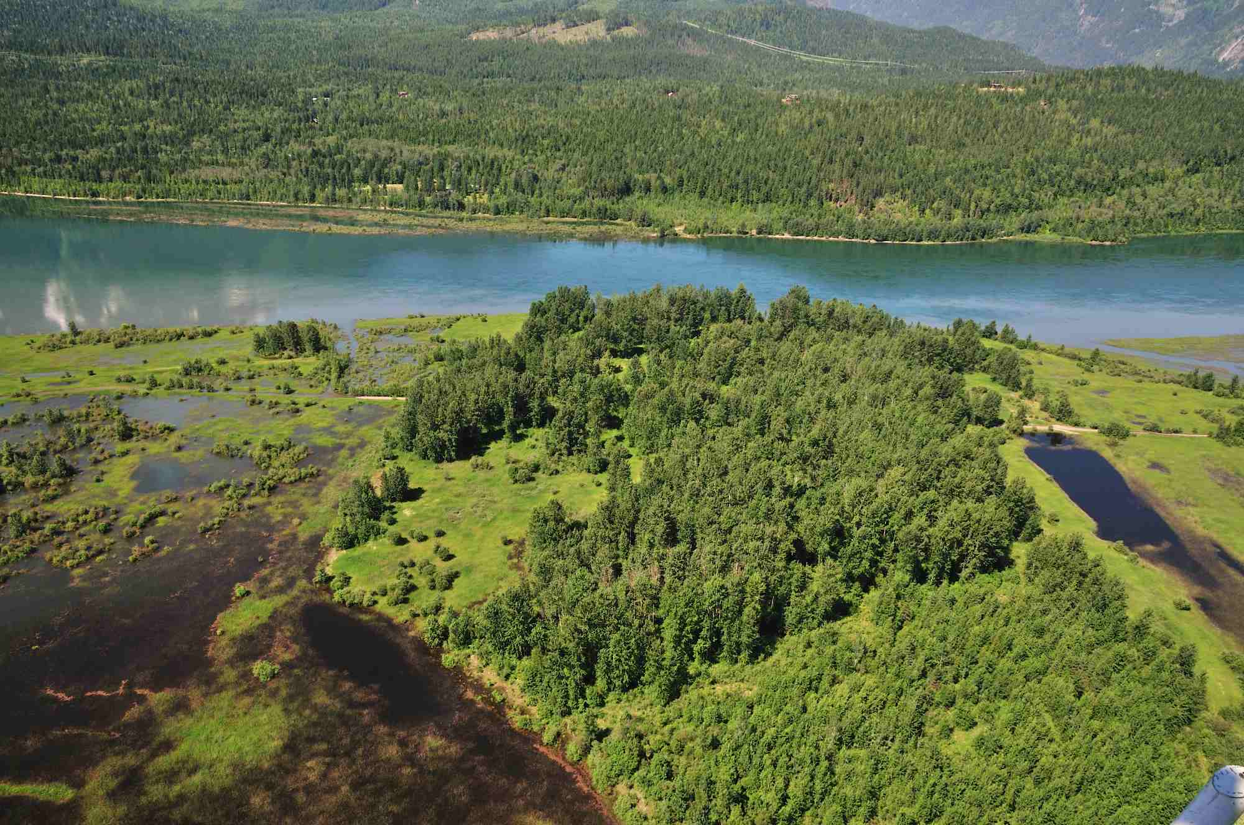

Slide 13
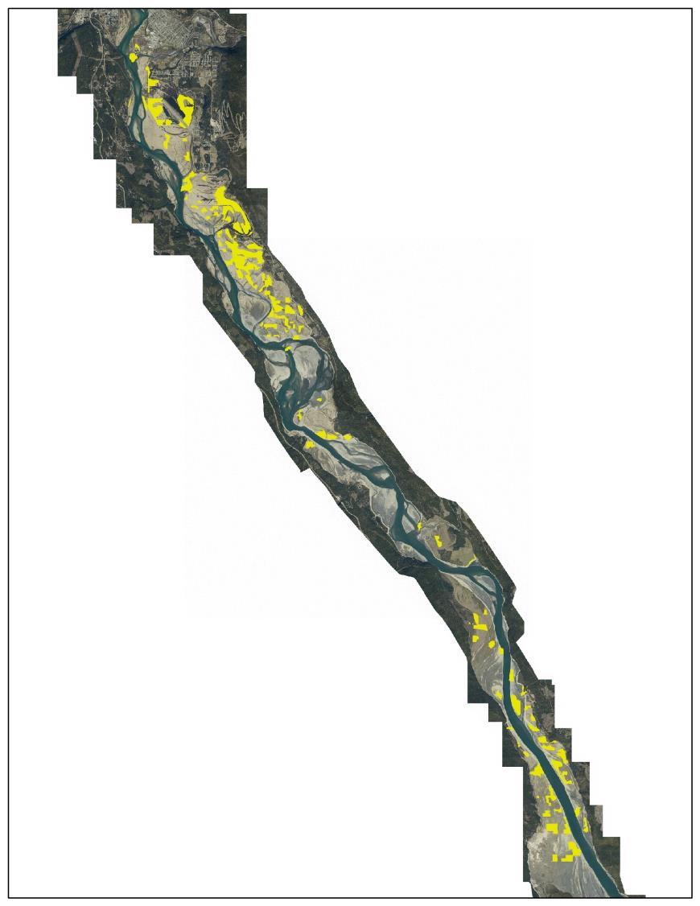
Grassland
Historic cover:
718 ha

Slide 14
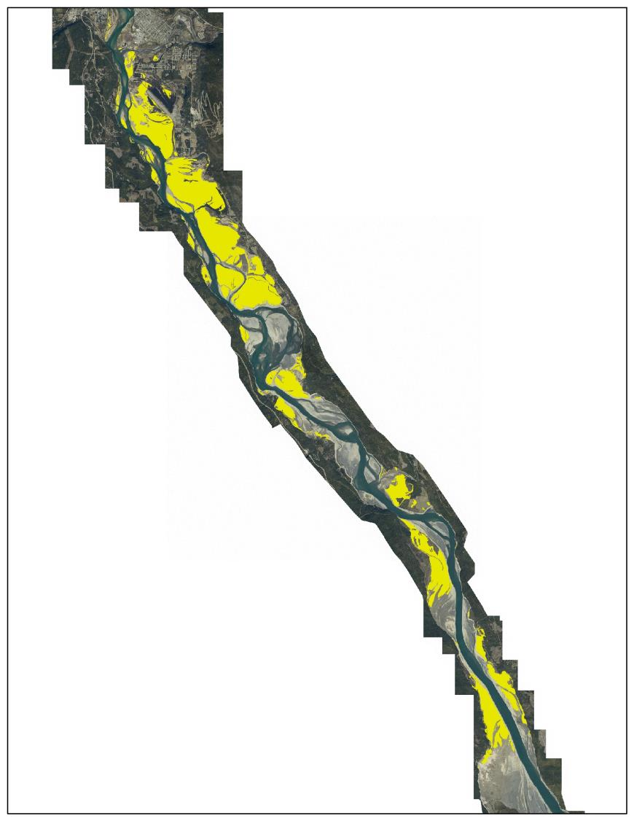
Grassland
Current cover:
2000 ha

Slide 15
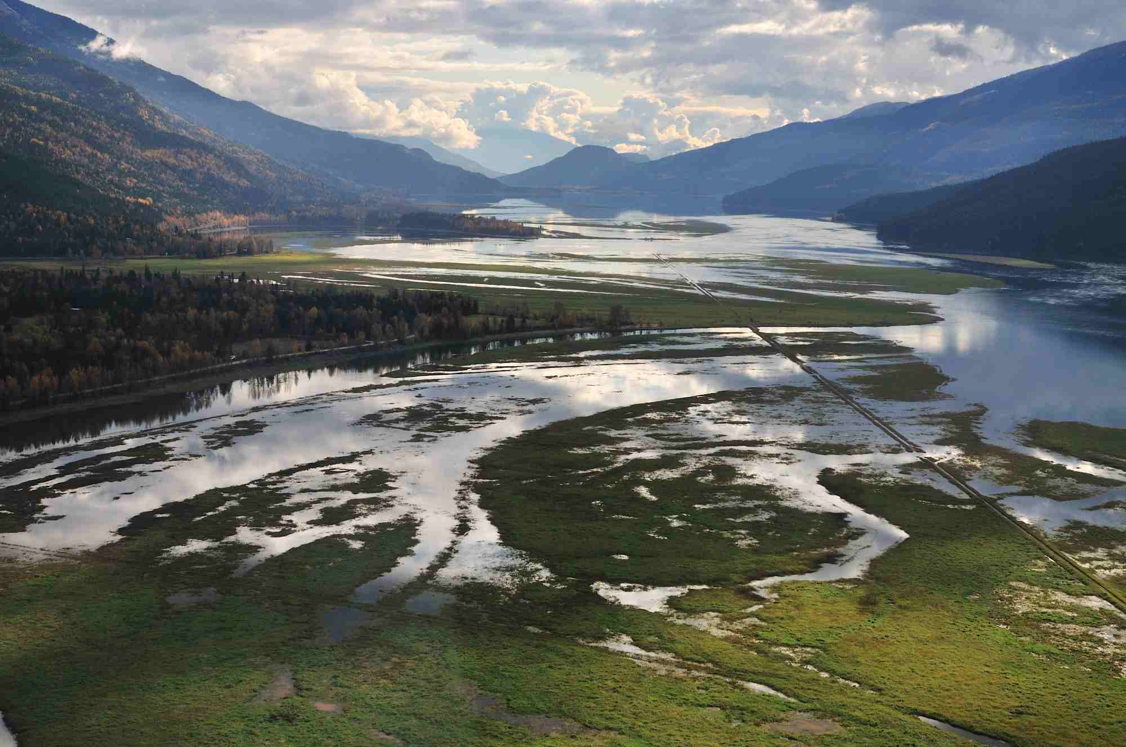

Slide 16
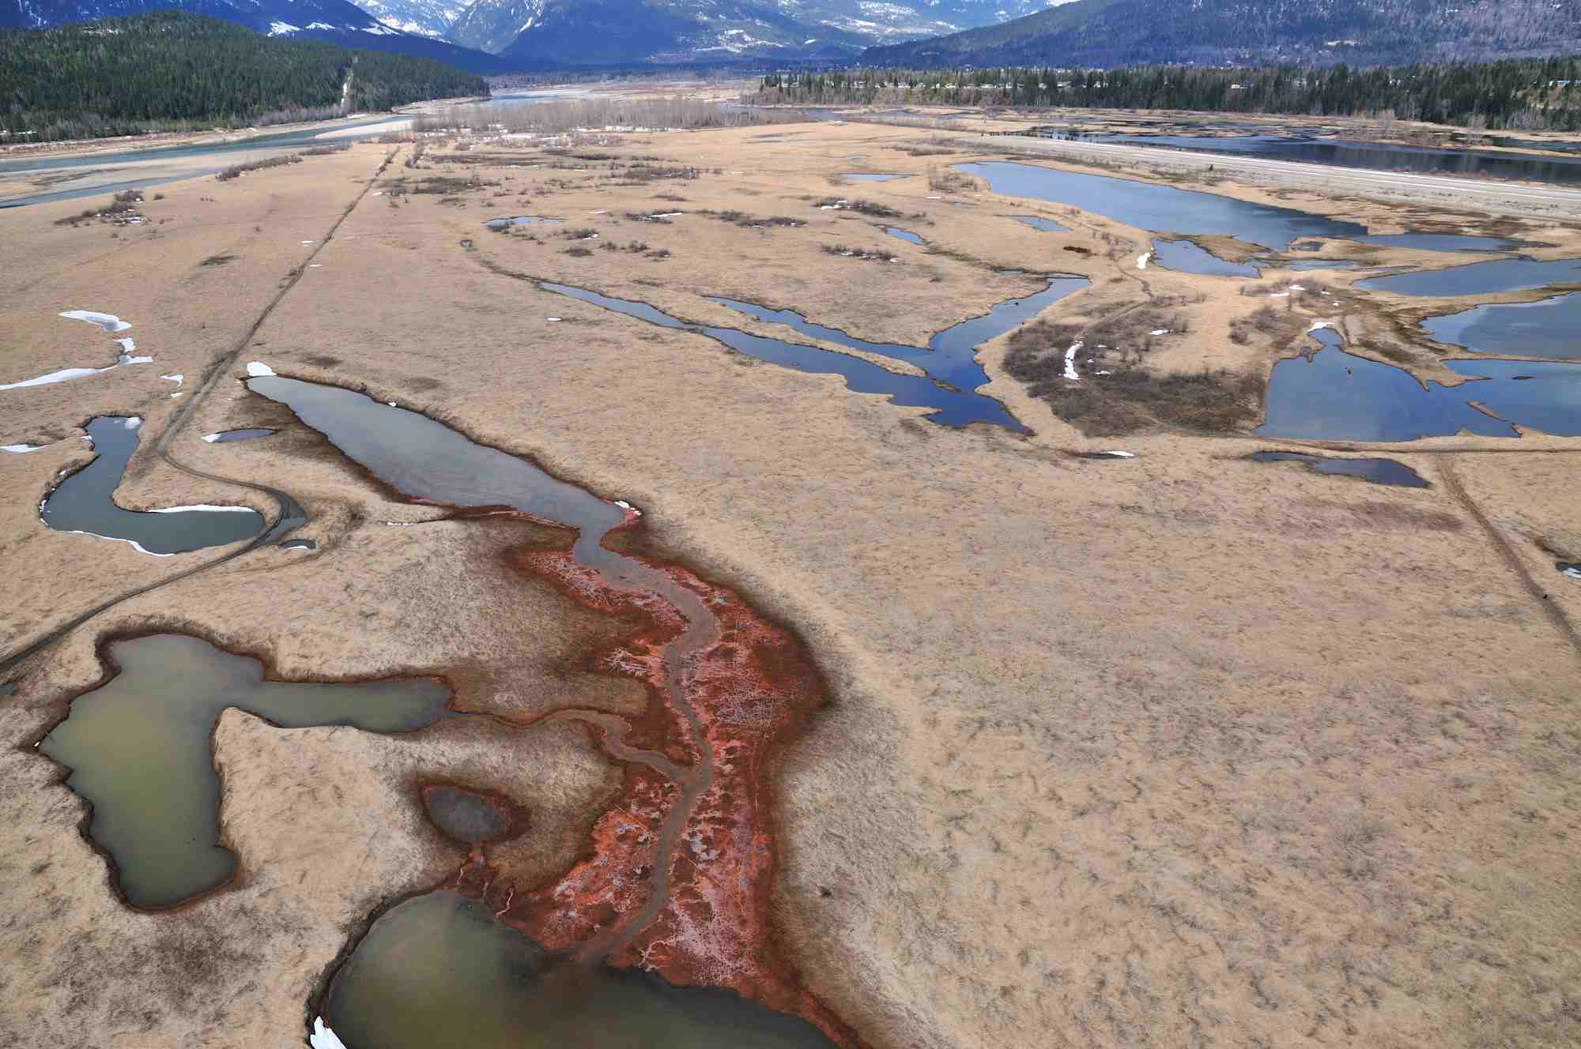

Slide 17
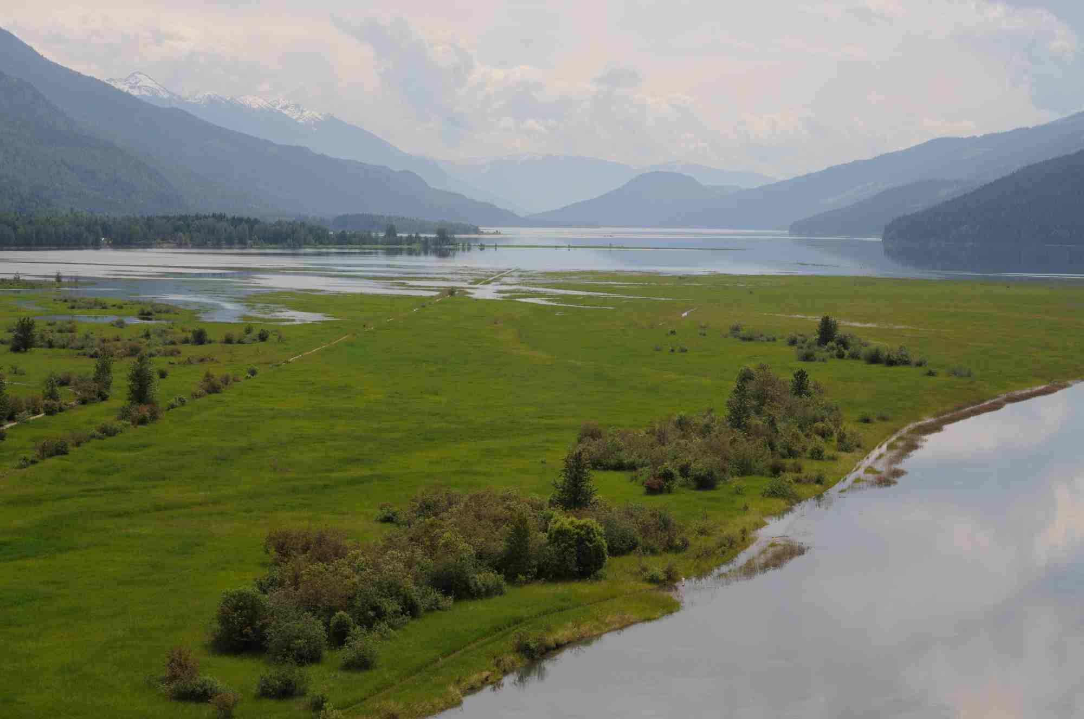

Slide 18
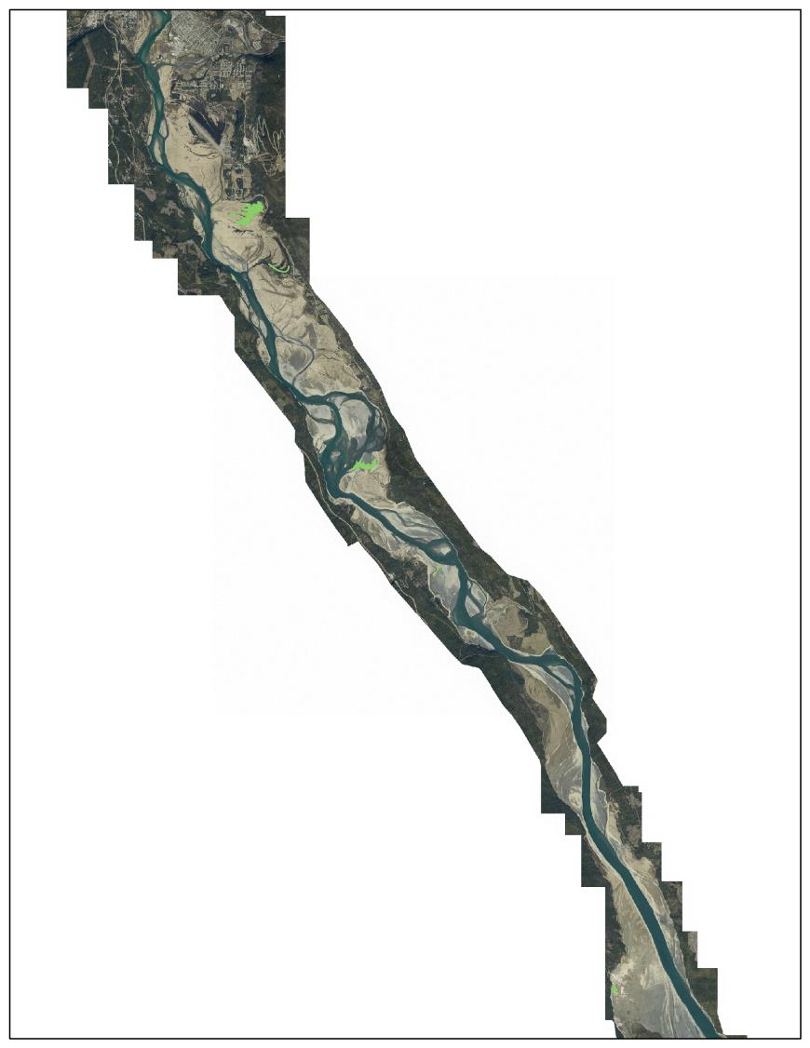
Wetlands
Historic cover:
62 ha

Slide 19
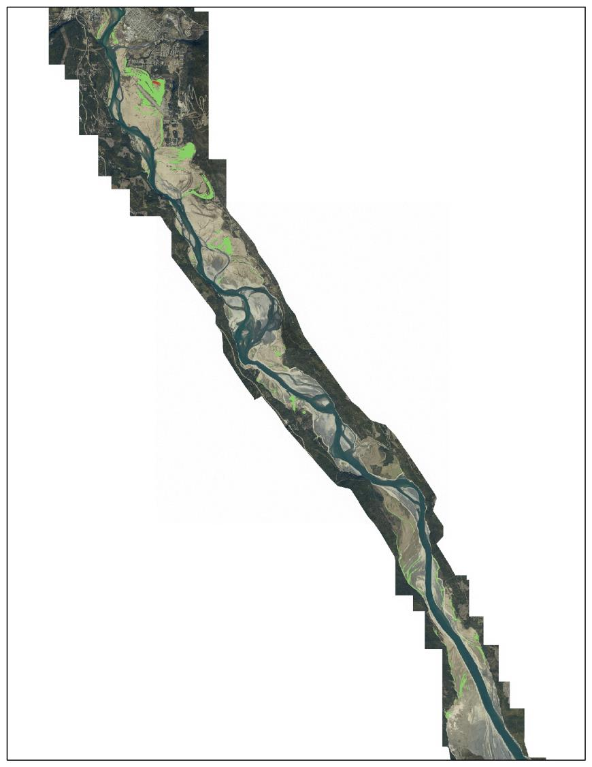
Wetlands
Current cover:
393 ha

Slide 20
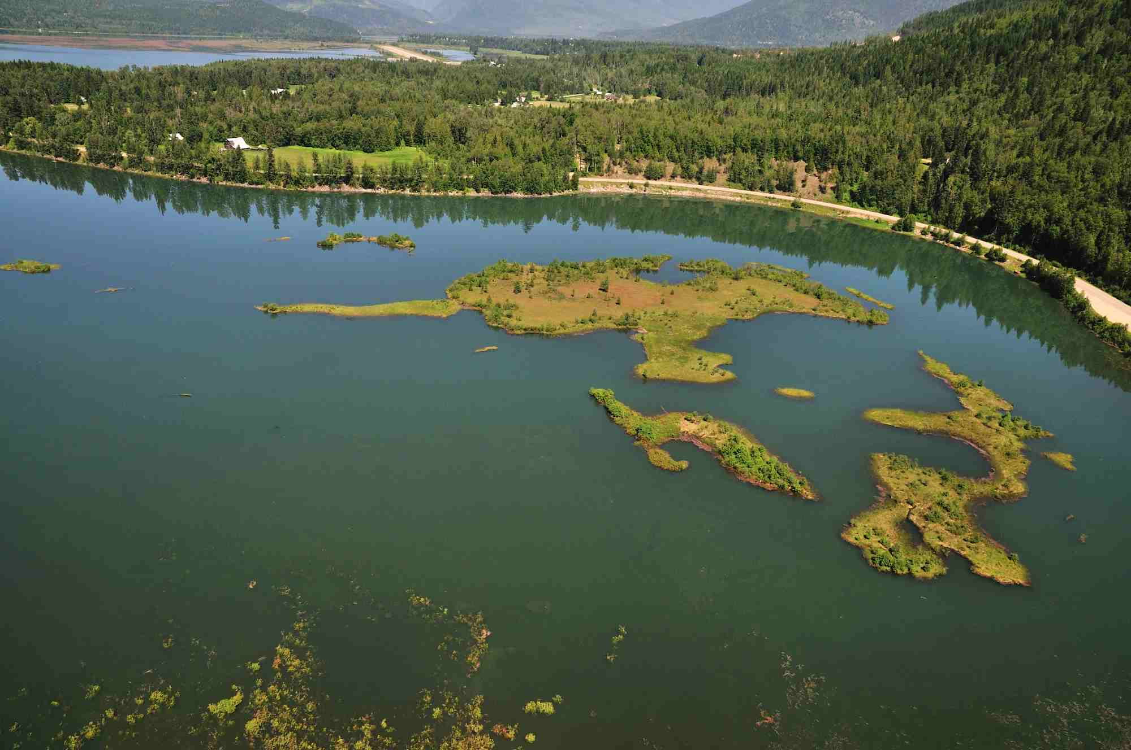

Slide 21
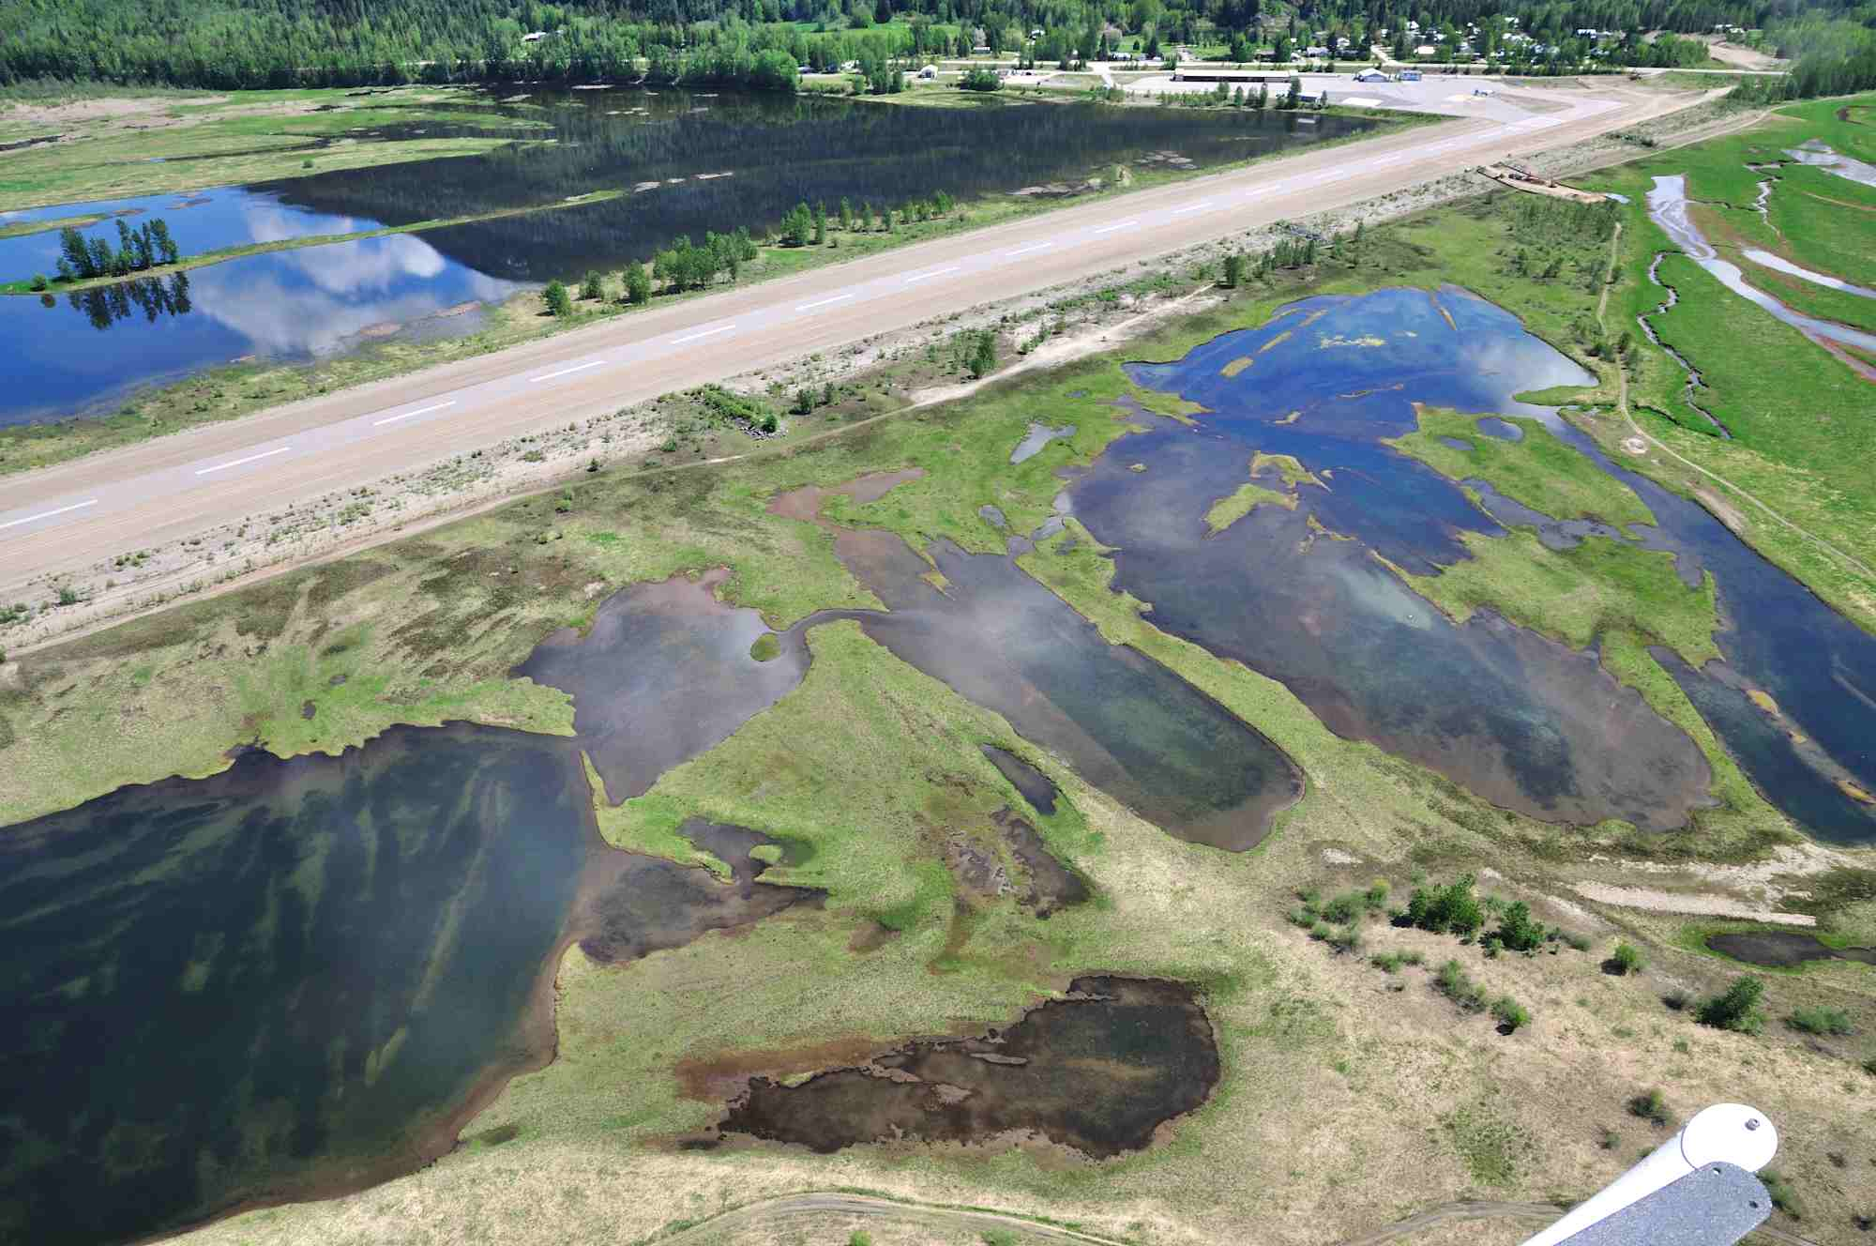

Slide 22
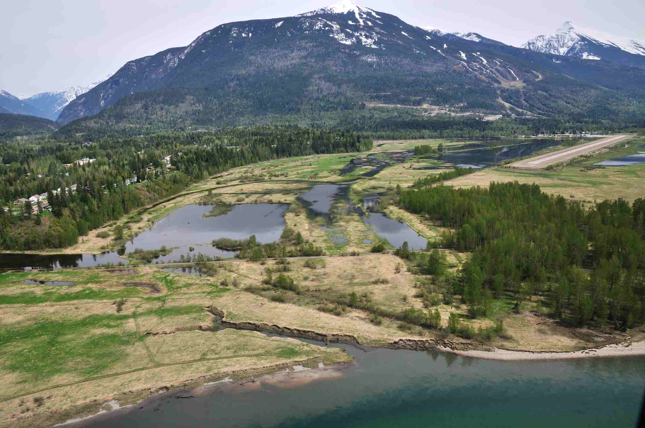

Slide 23
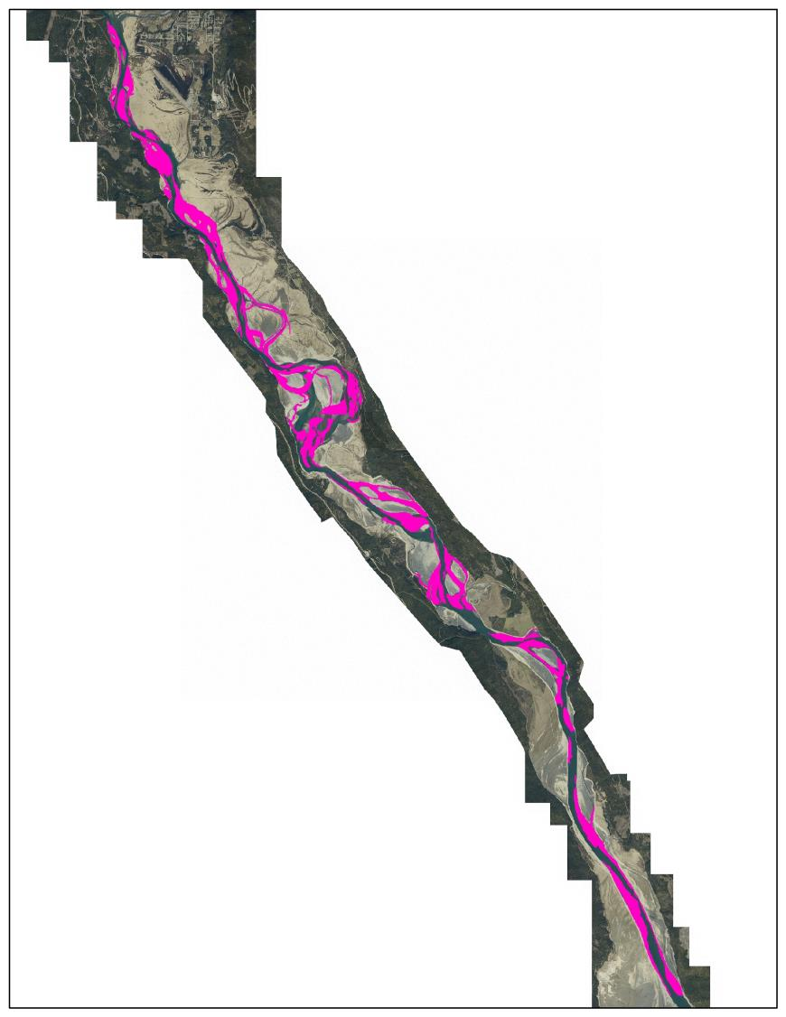
Gravel
Historic cover:
1097 ha

Slide 24
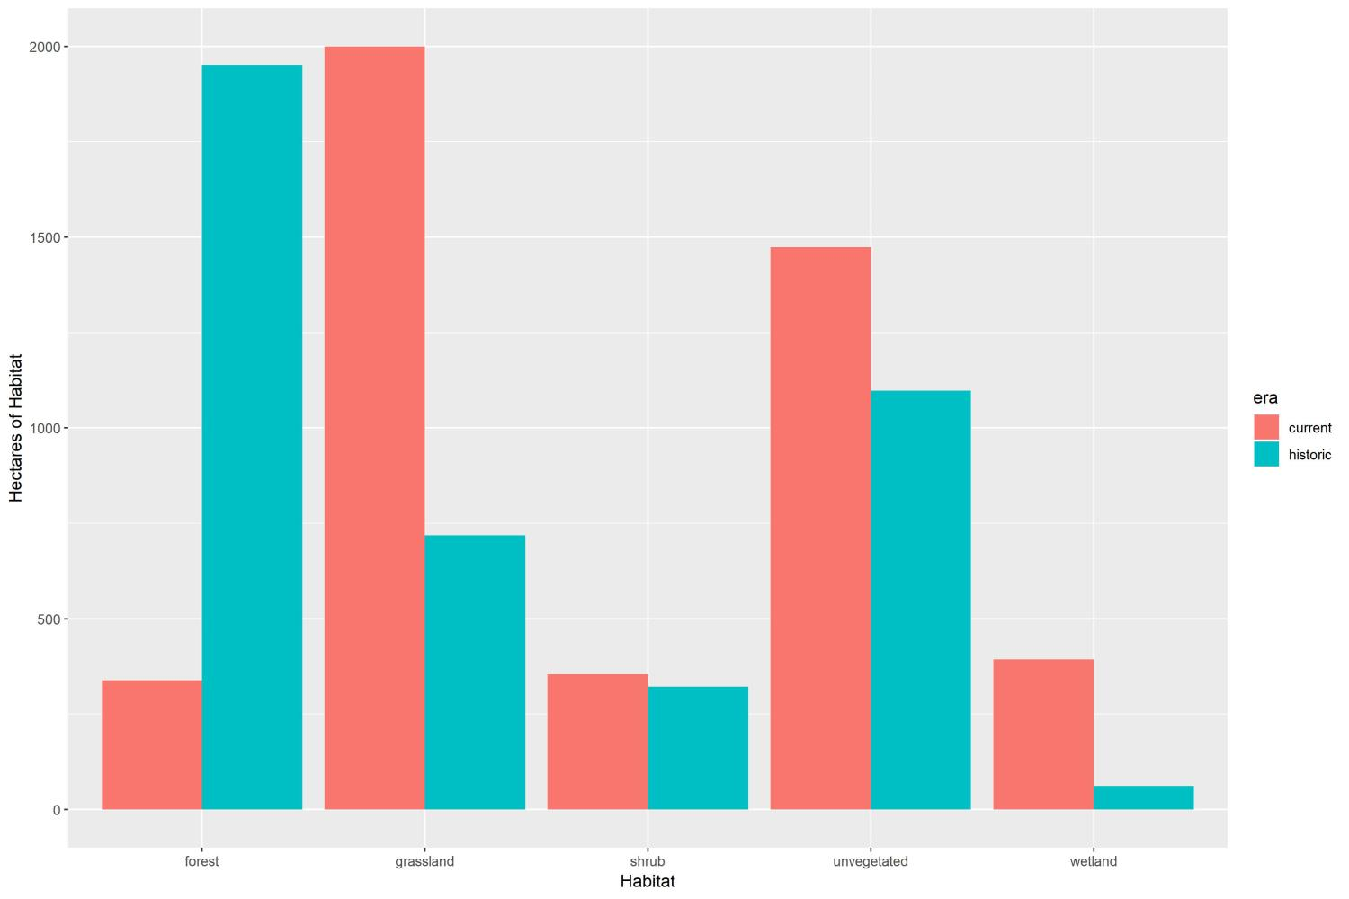

Slide 25
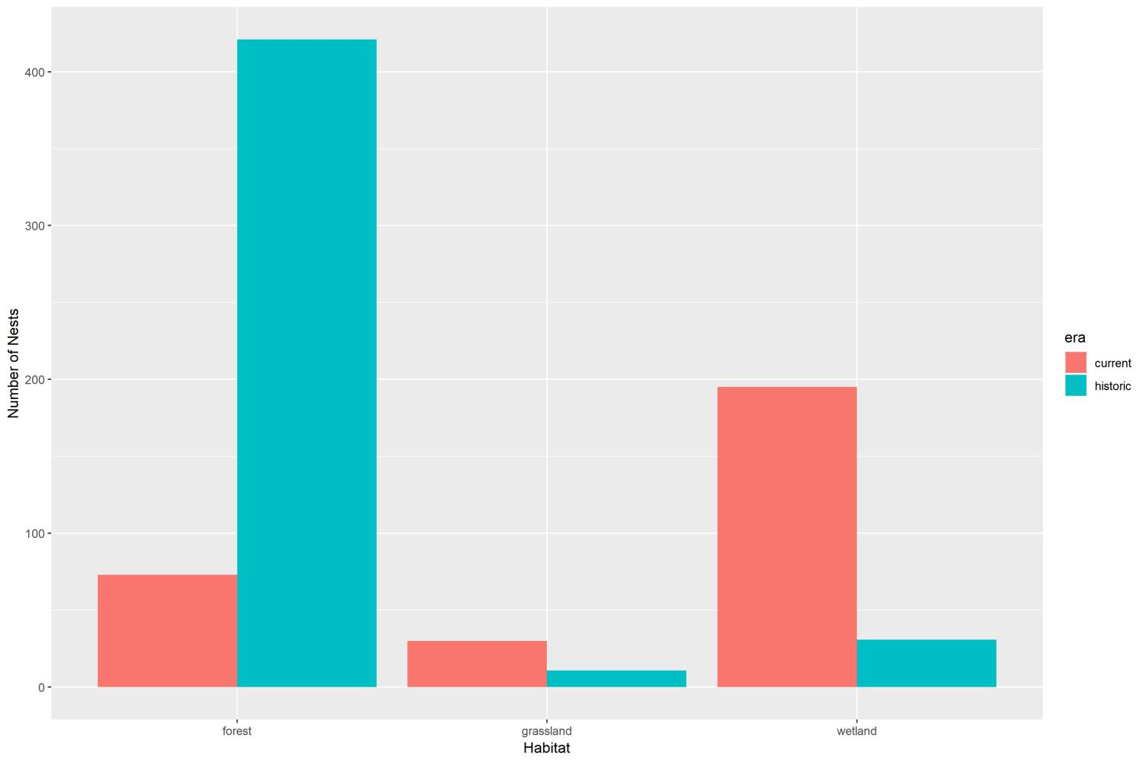

Slide 26
Future operations
Arrow Lakes Reservoir Mid-Elevation Scenarios: Scoping Evaluation (2016)
Scenario 1: ALR held at a constant 434.3m year round with a small drawdown in the spring and fall periods, and a flood event to full pool once in five years.
Scenario 2: ALR held slightly lower at 432.8m year round with a flood event to full pool once in seven years.

Slide 27
Habitat change under new scenarios:
Open grassland habitat will likely eventually convert to shrubbier habitat, but will regularly die-back from long-period flooding.
Cottonwood may colonize lower reservoir elevations, but could not tolerate deep inundation on those full-pool years, so its unlikely forested habitat would develop in any substantial way.
Improved wildlife habitat, and increased productivity on low years would probably offset losses during full pool years.
Species susceptible to flooding will have variable impacts.
Likely loss of open habitat may preclude Short-eared Owls and Northern Harrier from nesting – a positive.
More shrubby habitat will increase opportunities for shrub-nesting species to nest in the DDZ, on low years this will offset those full pool years.

Slide 28
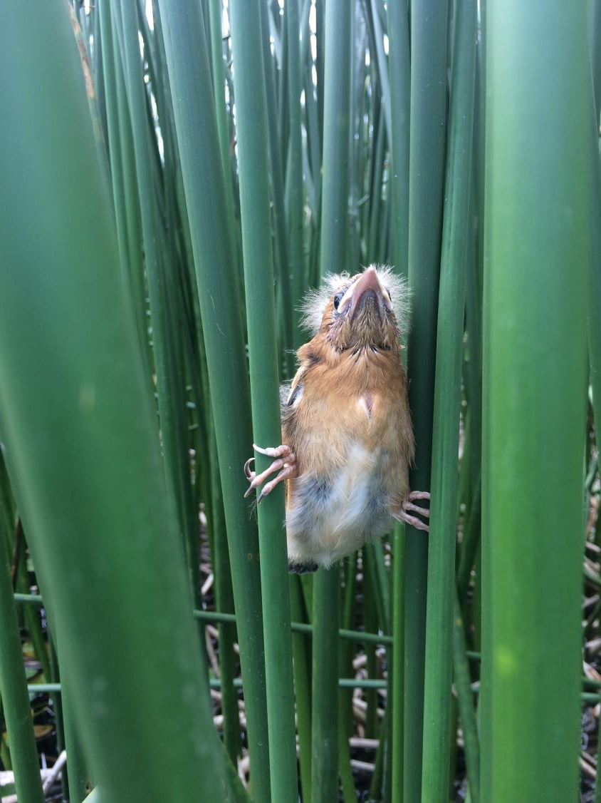
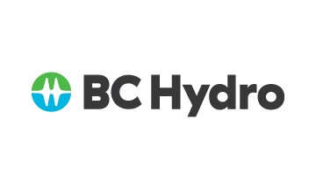
Thanks!

